Slide 1

Computer Society of India – Hyderabad Chapter
Online Summer Internships 2026
AI EMAIL WRITER
A MINI PROJECT ON
UNDER THE GUIDANCE OF
Prof.. Rajashree Sutrawe
MC Member, CSI Hyderabad Chapter
BY
Komirelly Sneha (23891A05F6)
Vignan Institute of Technology and Science

Slide 2
Overview
Abstract
Introduction
Literature survey
Scope & Objective of Project
Hardware & Software requirements
System Architecture
Modules
Code
Snapshots
Conclusion
References

Slide 3
ABSTRACT
In today's digital world, email communication plays an important role in education, business, and professional environments. Writing effective emails requires proper formatting, tone, and clarity, which can be challenging for many users.
The proposed AI Email Writer is a Flask-based web application that automatically generates professional emails based on user input. It provides features such as smart subject generation, multiple email templates, tone selection, multilingual support (English, Hindi, Telugu), voice input, email history, copy functionality, and PDF/TXT download options.
The system provides a simple and user-friendly interface that helps users generate high-quality emails quickly and efficiently.

Slide 4
EXISTING SYSTEM
In the existing system, users manually write emails using traditional email platforms.
Limitations:
Users need to create email content from scratch.
Time-consuming for professional emails.
Difficulty maintaining proper email format.
Users may not know the correct professional tone.
No automatic subject generation.
Limited personalization.
Examples:
Gmail
Outlook
Yahoo Mail
These platforms provide email sending features but do not help users generate complete email content.

Slide 5
PROPOSED SYSTEM:
The proposed system is an AI-powered Email Writing Assistant that automatically generates emails based on user requirements.
Features:
User enters email purpose/topic.
Selects email tone:
Formal
Casual
Polite
Selects language:
English
Hindi
Telugu
Adds:
Recipient Name
Sender Name
Generates:
Email subject
Complete email body
Additional Features:
Smart subject generation
Email templates
Voice input
Copy email

Slide 6
LITERATURE SURVEY
Previous systems focused mainly on email management, but AI-based generation improves content creation and personalization.
Research/Technology | Description
Natural Language Processing (NLP) | Used for understanding user input and generating human-like text
Generative AI Models | Used for automated text creation and language generation
Email Automation Systems | Help reduce manual effort in communication
Speech Recognition Technology | Converts voice input into text
Web Applications | Provide accessible platforms for users

Slide 7
SCOPE OF PROJECT
The scope of AI Email Writer includes:
Automated email content generation.
Professional email writing assistance.
Multilingual email support.
Improving communication efficiency.
Helping students, employees, and professionals.
Reducing time spent on email drafting.
Future scope:
Direct email sending.
User accounts.
AI model integration.
Advanced personalization.
Industry-specific email templates.

Slide 8
OBJECTIVE OF PROJECT
The main objectives are:
To develop an application that automatically generates professional emails.
To reduce manual effort in email writing.
To provide personalized email content.
To support multiple languages.
To provide different writing tones.
To improve communication quality.
To create an easy-to-use interface.

Slide 9
Software Requirements
Operating System:
Windows / Linux / macOS
Frontend:
HTML
CSS
JavaScript
Backend:
Python
Flask Framework
Libraries:
Flask-CORS
Speech Recognition API
Development Tools:
Visual Studio Code
Web Browser
Deployment:
Render / Vercel

Slide 10
HARDWARE REQUITREMENTS Minimum Requirements: Processor: Intel i3 or above RAM: 4 GB minimum Storage: 500 MB available space Input Devices: Keyboard Mouse Microphone (for voice input) Display: Standard monitor

Slide 11
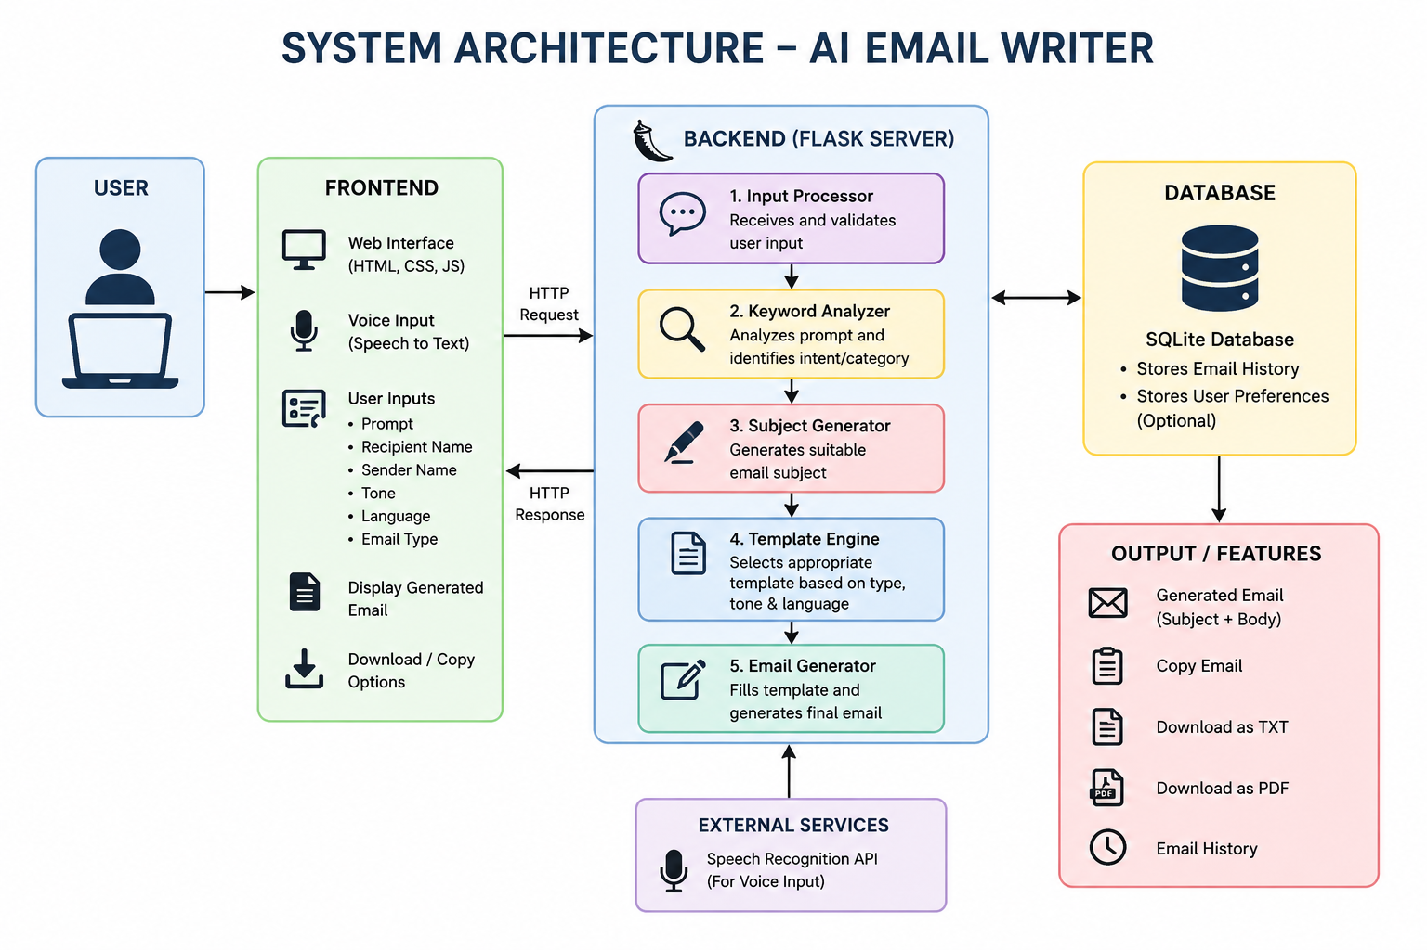
SYSTEM ARCHITECTURE

Slide 12
TECHNOLOGY USED:
Frontend Technologies
HTML
Used to create webpage structure.
CSS
Used for styling, responsive design, and dark mode.
JavaScript
Used for:
User interaction
API calls
Copy feature
Voice input
Backend Technology
Python Flask
Used for:
Handling requests
Processing user input
Generating email content
Connecting frontend and backend

Slide 13
ALGORITHMS USED 1. Rule-Based Text Generation Algorithm Steps: Receive user input. Analyze keywords. Identify email category. Select suitable template. Generate subject. Create email body. Display final email. 2. Smart Subject Generation Algorithm Steps: Take user prompt. Convert text into lowercase. Match keywords. Generate suitable subject.

Slide 14
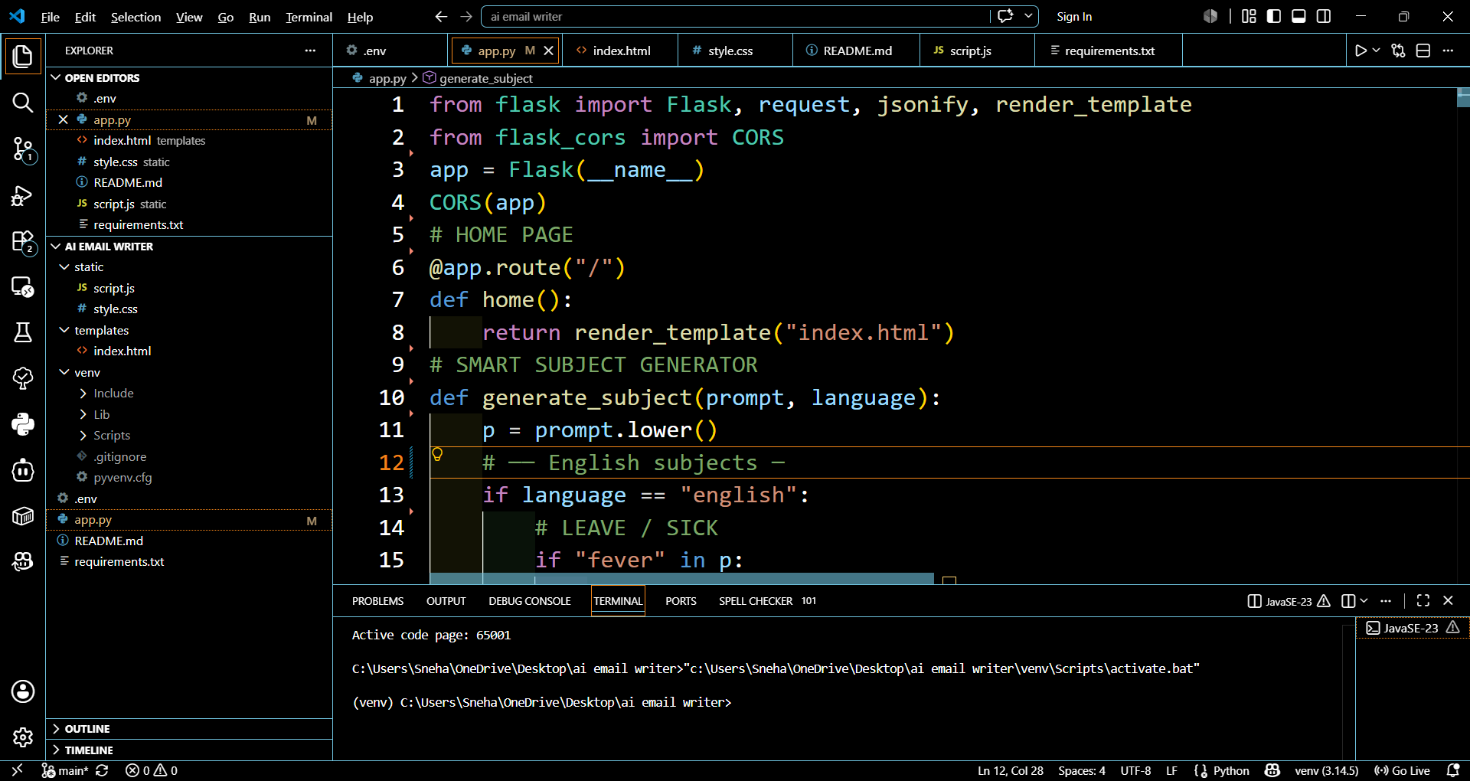
CODE

Slide 15
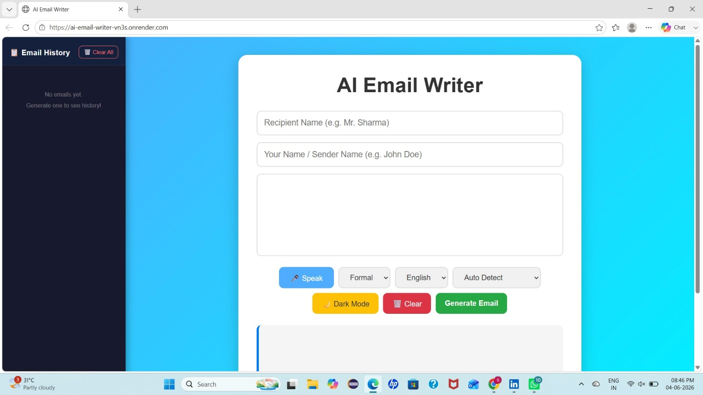
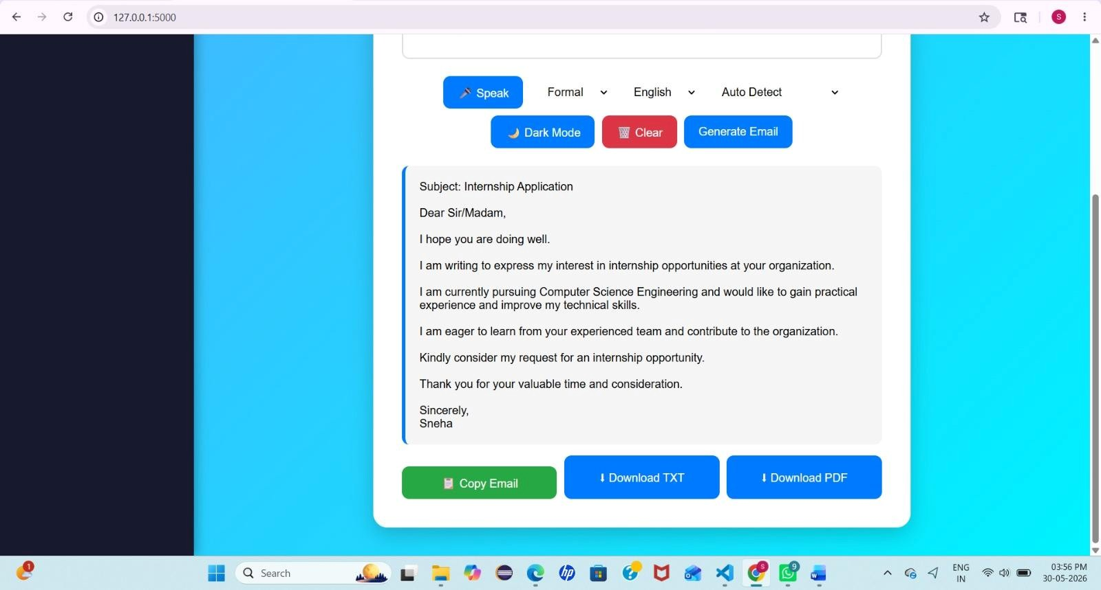

Slide 16
The AI Email Writer project provides an efficient solution for generating professional emails automatically. The application simplifies email writing by providing personalized content, multiple language support, tone selection, and useful productivity features. This project demonstrates how web technologies and intelligent text processing can improve everyday communication.
CONCLUSION

Slide 17
REFERENCES Flask Documentation https://flask.palletsprojects.com/ Python Documentation https://docs.python.org/ MDN Web Documentation https://developer.mozilla.org/ Natural Language Processing Concepts https://www.ibm.com/topics/natural-language-processing Speech Recognition API Documentation https://developer.mozilla.org/en-US/docs/Web/API/Web_Speech_API

Slide 18
Any Queries

Slide 19
THANK YOU

